Slide 1

Ostu- ja Hankejuhtimine
Purchasing and Procurement management?
Eduard Ševtšenko
2021

Slide 2
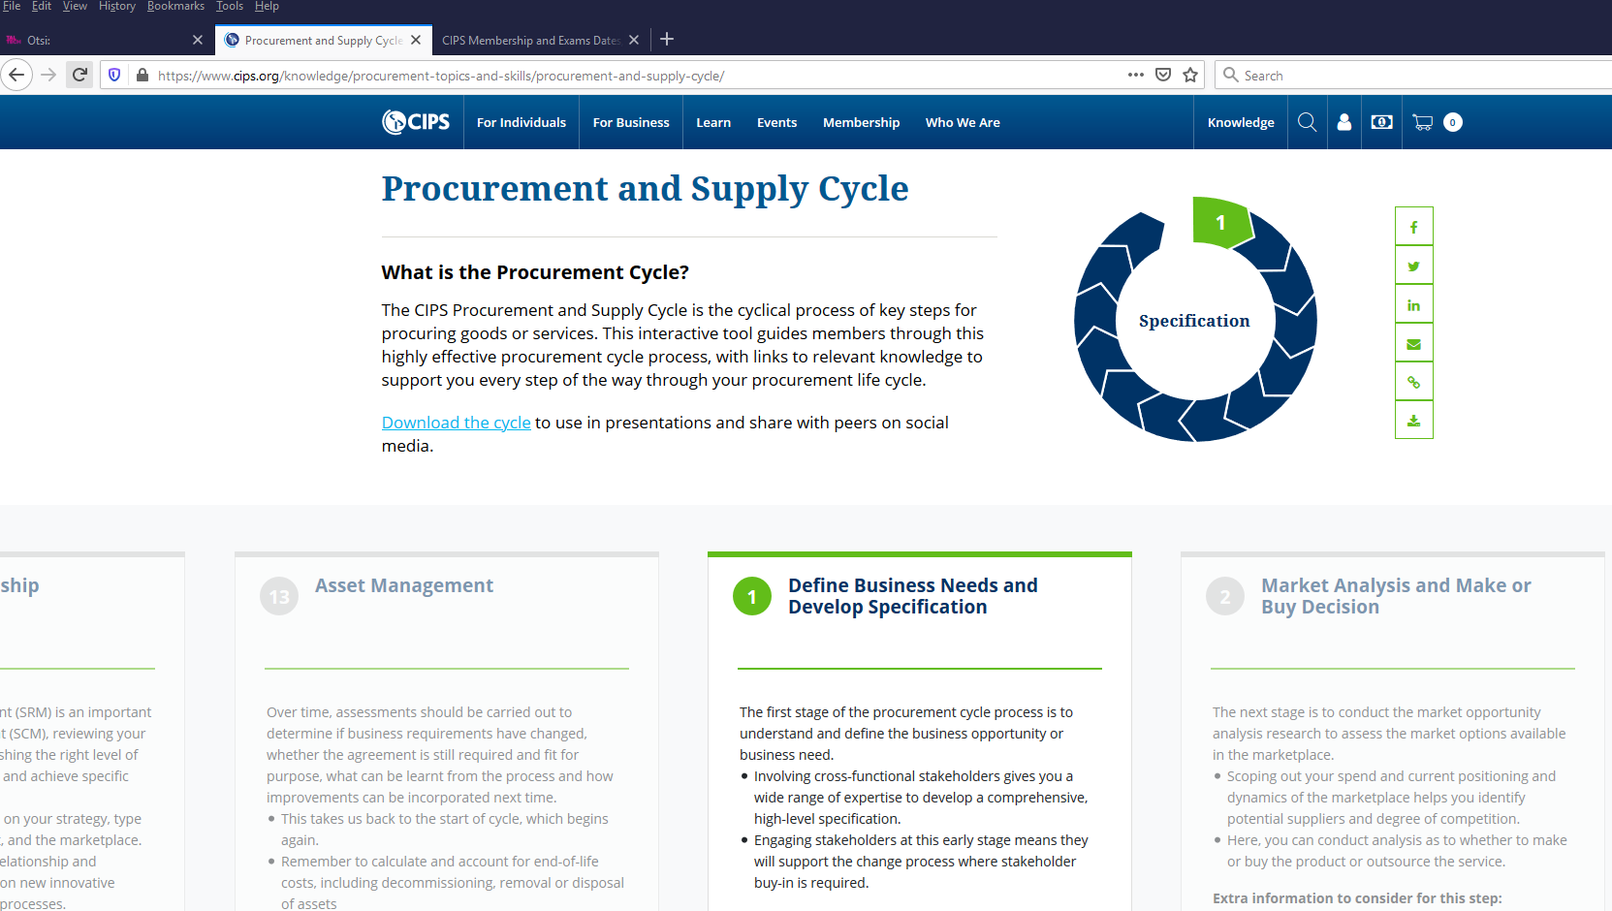
Supply chain

Slide 3
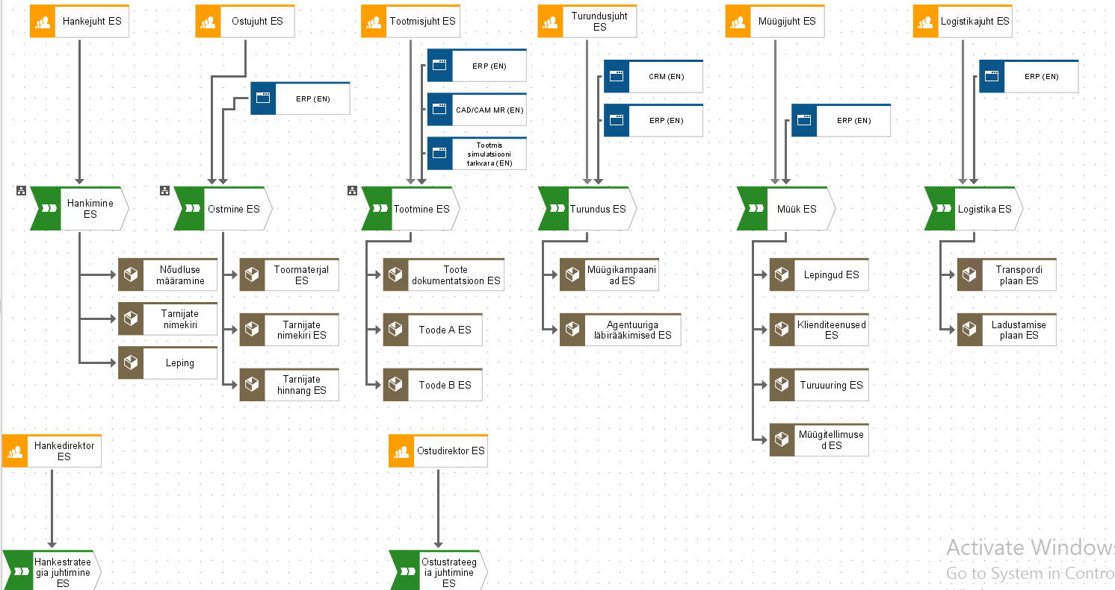
Supply chain

Slide 4
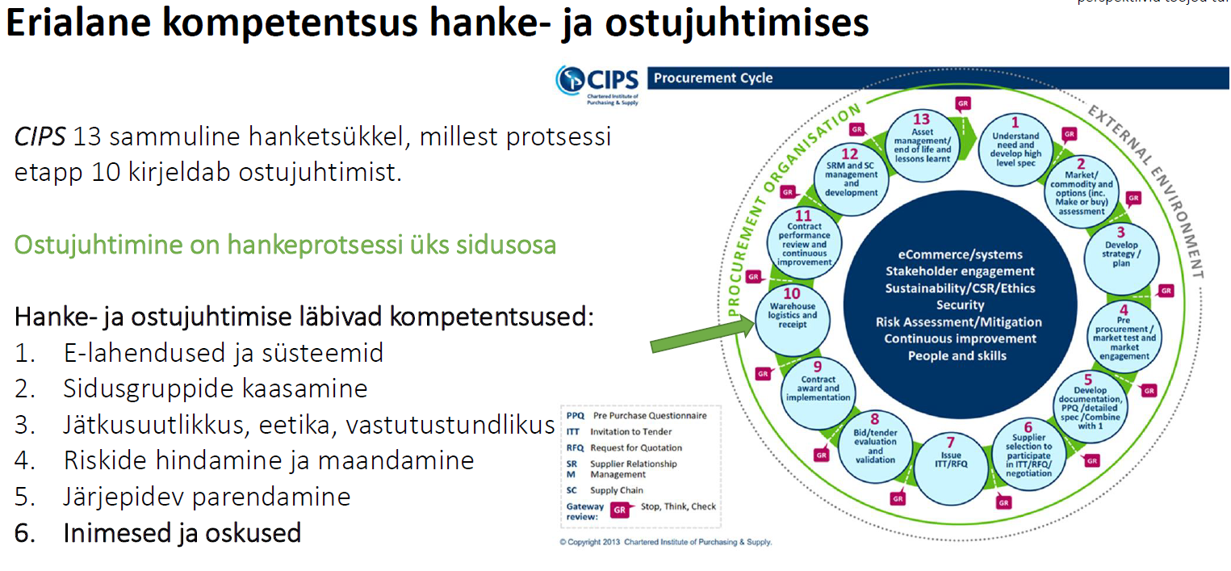
Kui kaugel on hanke digitaliseerimine?
Tarmo Saidla | Prolog Supply Chain Conference 20.02.2020

Slide 5
CIPS Chartered Institute of Procurement & Supply
Stage 1 – Understand need and develop a high level specification
Stage 2 - Market and Commodity and options (including make or buy assessment)
Stage 3 – Develop Strategy and Plan
Stage 4 - Pre-procurement / market test and engagement
Stage 5 - Developing Documentation, PQQ and Specification
Stage 6 – Supplier Selection to participate in ITT/ RFP/ Negotiation
Stage 7- Issue ITT/ RFP
Stage 8 – Supplier / Bid / Tender Evaluation
Stage 9 - Contract Award / Implementation
Stage 10 - Warehouse Logistics and Receipt
Stage 11 - Contract Performance Review and Continuous Improvement
Stage 12 - Supplier Relationship Management and Supplier Contract Management
Stage 13 – Asset management /end of contract review
https://www.cips.org/knowledge/procurement-topics-and-skills/risk-mitigation/counterfeit/

Slide 6
Procurement definitions
is the business management function that ensures identification, sourcing, Access and management of the external resources that an organisation needs to fulfill its strategic goals
Pro-active, strategic corporate activity to ensure a continuing supply of goods and services to enable world-class organisational performance
Manages supply chain risks through the effectvie negotiation of contracts, cost and price models, quality and other essential supply characteristics
Procurement and Supply Chain Management
Kenneth Lysons and Brian Farrington

Slide 7
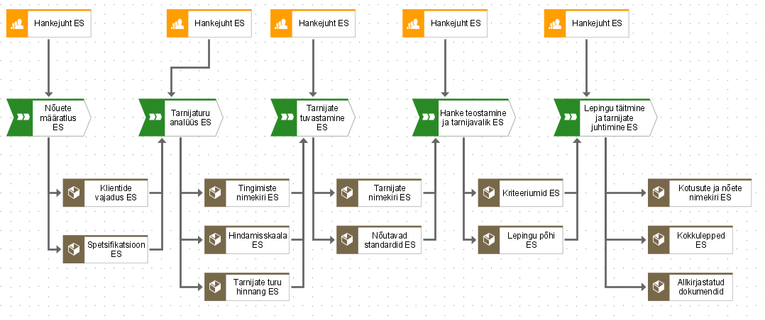
Kui kaugel on hanke digitaliseerimine?
Tarmo Saidla | Prolog Supply Chain Conference 20.02.2020

Slide 8
Purchasing
No certain definition of Purchasing, it is a term to describe the activity of commiting expenditure: Purchasing, Buying, Procurement, Materials Management, Supply Chain Management, Purchasing and Supply Chain Management, Sourcing Management
Purchasing and Supply Chain Management
Kenneth Lysons and Brian Farrington

Slide 9
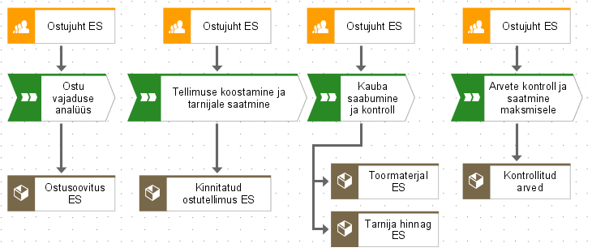
Kui kaugel on hanke digitaliseerimine?

Slide 10
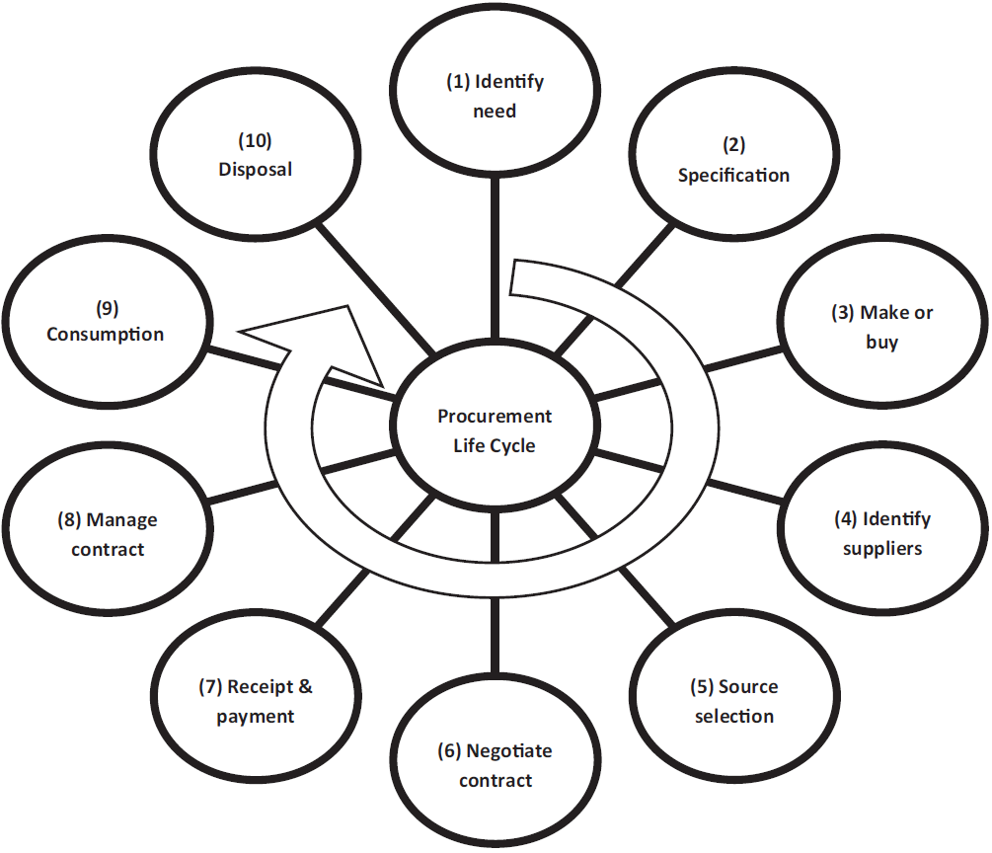
THE PROCUREMENT MODELS HANDBOOK
Third Edition
Andrea Cordell and Ian Thompson

Slide 11
Evolution of purchasing to procurement
Period 1: The early years (1850-1900)
Period 2: Growth of procurement Fundamentals (1900-1939)
Period 3: The war years (1940-1946)
Period 4: The quiet years (1947-1960)
Period 5: Material management comes of age (1960-1970)
Period 6: The global era (1970-1999)
Period 7: Integrated Supply Chain management (2000..)z
Procurement and Supply Chain Management
Kenneth Lysons and Brian Farrington

Slide 12
Procurement Life Cycle
Stage 1 – Identify need. The life cycle is initiated with the identification of a need. The business has a requirement and a purchase is required to fulfil it.
Stage 2 – Specification. This is the documented statement of requirements. It is then used by suppliers to assist with technical and pricing decisions.
Stage 3 – Make or buy? The ‘make’ decision involves the organisation proceeding to fulfil the need internally, whereas the ‘buy’ decision requires the organisation to purchase from a third party.
Stage 4 – Identify suppliers. This stage involves searching and analysing the supply market; it is about identifying suitable and appropriate resources.
Stage 5 – Source selection. This involves identifying the preferred supplier to supply the goods or services required, possibly through a tendering or RFx exercise.
Stage 6 – Negotiate contract. Once a supplier has been selected there may need to be several rounds of negotiation or clarification in order to agree the final commercial and contractual details.
Stage 7 – Receipt and payment. Payment for goods and services usually occurs after receipt, although this is not always the case. This is often referred to as ‘purchasing’ or even ‘purchase-to-pay’ (P2P).
Stage 8 – Manage contract. The contract needs to be managed in order to ensure performance by the supplier. This stage is also sometimes referred to as supply management.
Stage 9 – Consumption. The bought-in goods and serviced are utilised during the life of the contract and may need replenishment, maintenance or some form of service management.
Stage 10 – Decommission and disposal. The end of the life cycle involves the disposal of the product. This is important in view of the drivers for sustainability and whole life costs.
THE PROCUREMENT MODELS HANDBOOK Third Edition
Andrea Cordell and Ian Thompson

Slide 13
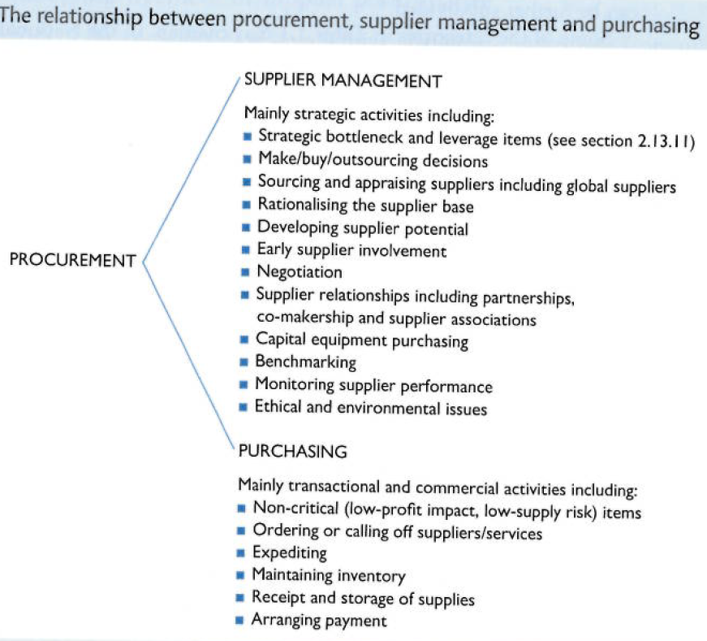
Procurement, supplier management and purchasing
Procurement and Supply Chain Management
Kenneth Lysons and Brian Farrington

Slide 14
Top five procurement technology trends
Integrating a digital transformation strategy
Adopting artificial intelligence systems
Cybersecurity systems and protection
Using big data to drive decisions
Block chain infrastructure and transactions.
https://www.cips.org/knowledge/procurement-topics-and-skills/procurement-technology/

Slide 15
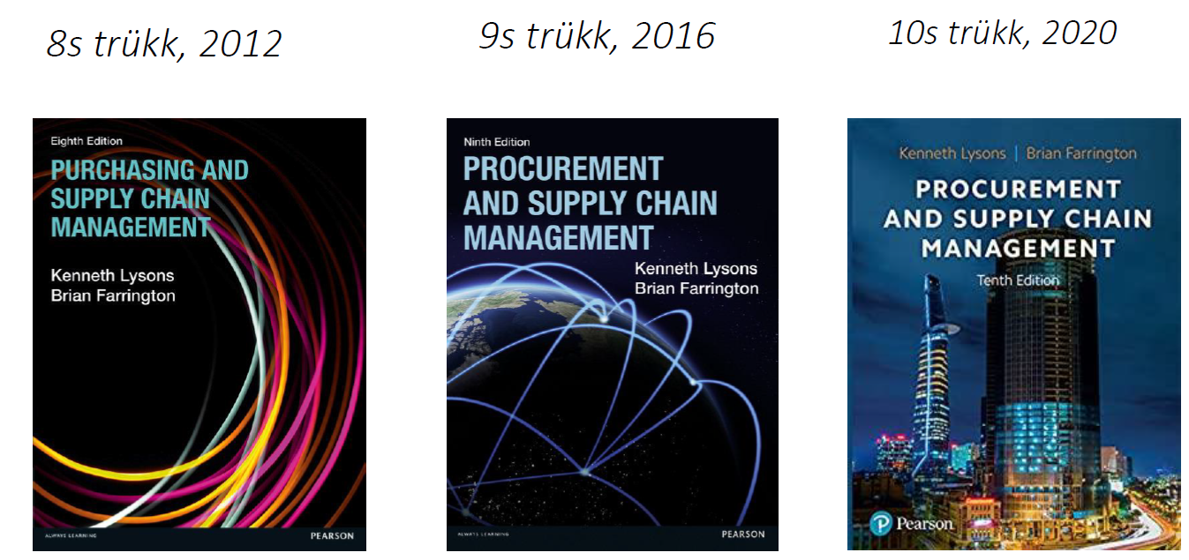
Kui kaugel on hanke digitaliseerimine?
Tarmo Saidla | Prolog Supply Chain Conference 20.02.2020

Slide 16
Link to related video:
https://www.dropbox.com/s/6qwgbiabj979vjq/DIGILOG%20%28Purchase%26Procurement%29.mp4?dl=0

