Slide 1
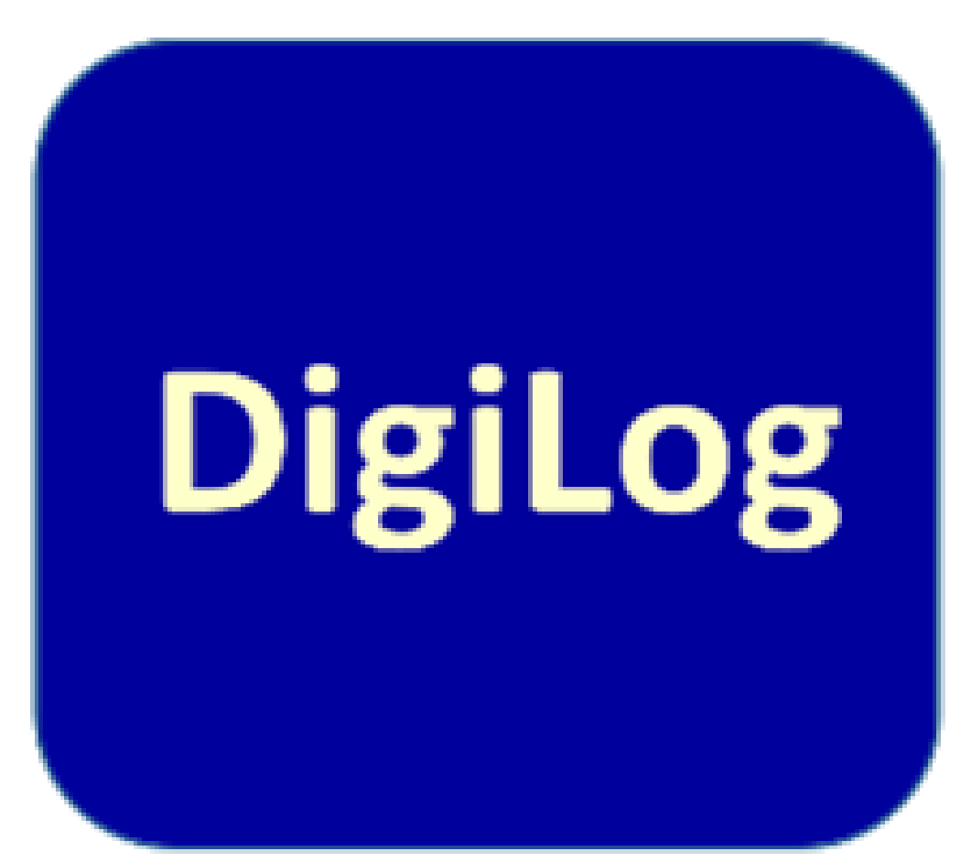


Result:
Use of Simulation tools
DIGILOG Digitally supported and virtual study practices for modern logistic systems
Oliver Kallas
Tallinn University of Applied Sciences
08.05.2021

Slide 2

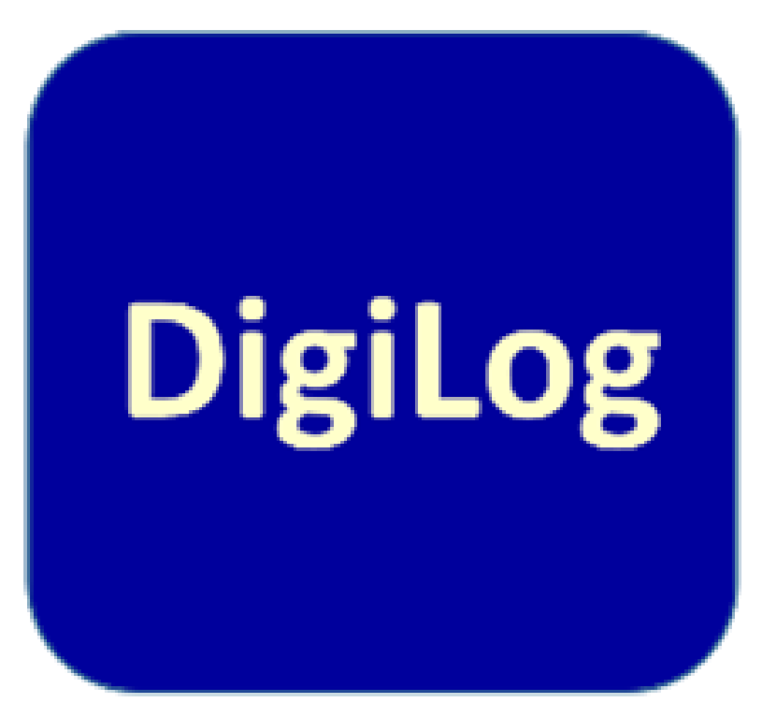
Main goal
The goal of the DIGILOG project was to develop a study module for use in professional higher education that focuses on transportation management and logistics multinational working environment and takes into account the ever-increasing use of digital decision support systems and simulation tools.

Slide 3

The future of higher education in Europe
Online technologies may radically change how we will define higher education, as artificial intelligence and online platforms play an increasing role in research and teaching.
The boundaries of fixed rooms and fixed timetables are blurring, which could significantly change curricula, pedagogies and subject matter, as well as research, teaching and learning roles.

Slide 4
The future of higher education in Europe
Vision: a Europe in which learning, studying and doing research would not be hampered by borders. A continent, where spending time in another Member State – to study, to learn, or to work – has become the standard.

Slide 5
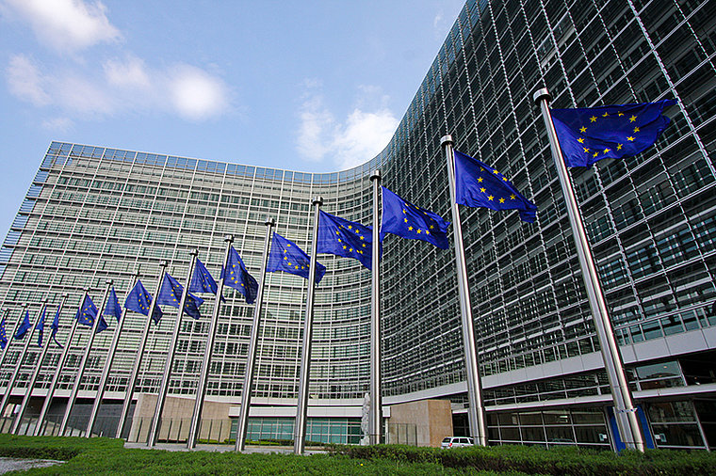
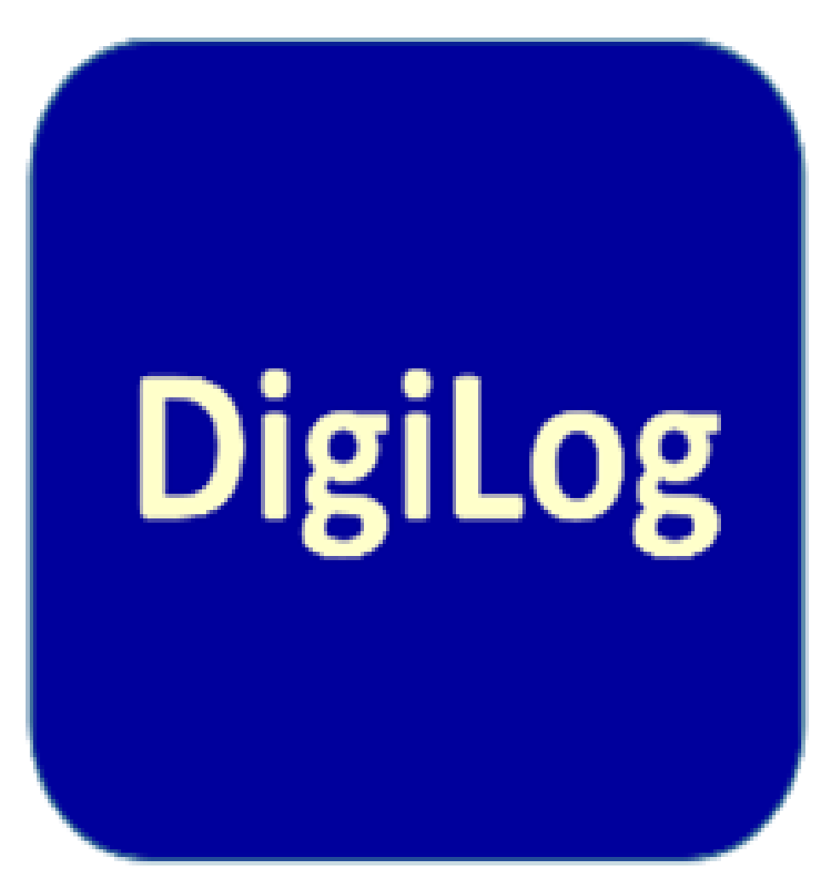

The Digital Education Action Plan outlines the European Commission’s vision for high-quality, inclusive and accessible digital education in Europe.

Slide 6
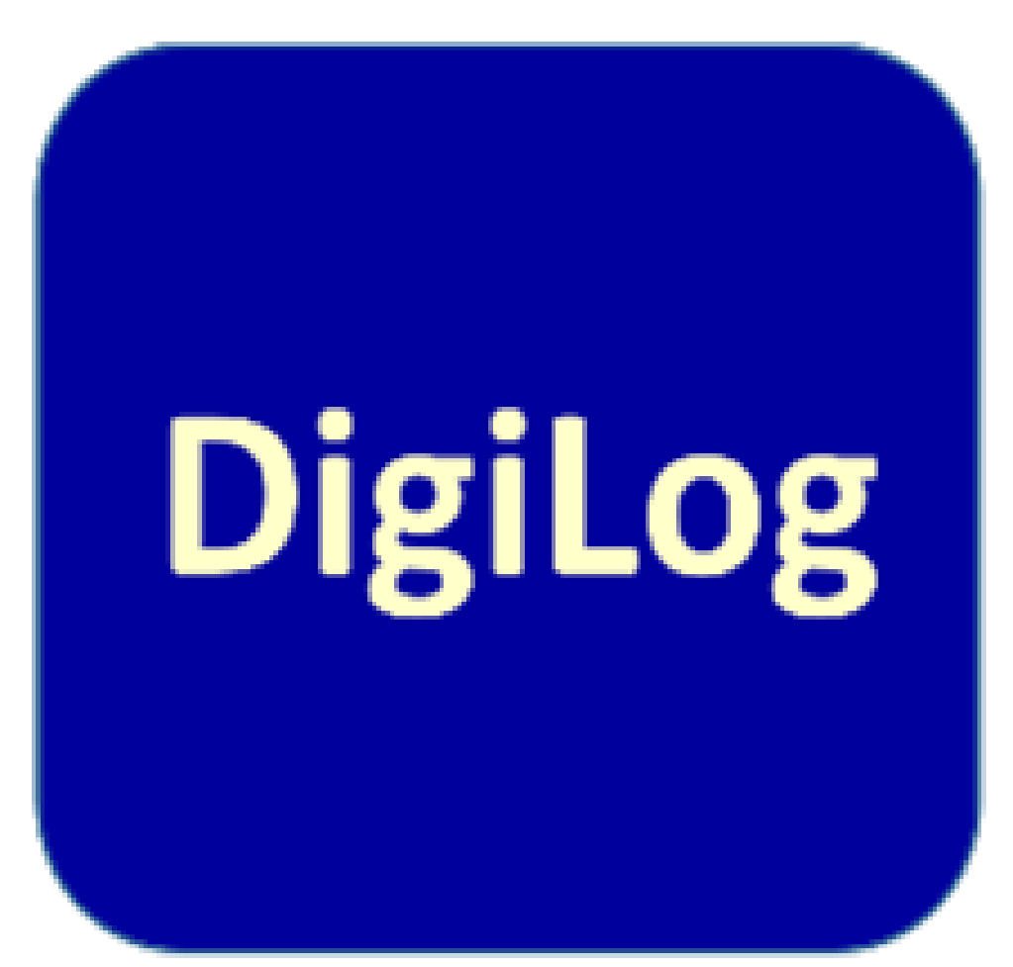

The new Action Plan has two strategic priorities:
Fostering the development of a high-performing digital education ecosystem.
Enhancing digital skills and competences for the digital transformation.

Slide 7
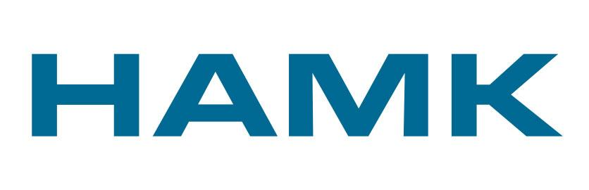


Partners
TTK, University of Applied Sciences, Estonia
HÄME, University of Applied Sciences, Finland
Transport and Telecommunication Insitute, Latvia
VTI, Swedish National Road and Transport Research Institute

Slide 8

Outputs
To develope study materials for the following subjects:
1. Supply Chain Management Simulation (TTK, 3 ECTS).
2. Effective warehouse design and process simulation (TTK, 3 ECTS).
3. Professional Competence of Transport Managers (TTI, 3 ECTS).
4. Game based multi‐criteria decision making for T&L competence development (TTI, 3 ECTS).
5. Passenger traffic railway markets are opening to competition (HAMK, 3 ECTS)
6. Train driving exercise for train dispatchers (VTI, 4 ECTS).
7. Simulation tool based on games strategy (TRELOGIC)

Slide 9

What is Supply Chain Management?
Supply chain management, the management of the flow of goods and services, money and information between businesses and locations, and includes the movement and storage of raw materials, of work-in-process inventory, and of finished goods as well as end to end order fulfillment from point of origin to point of consumption.

Slide 10

Vizualisation of Supply Chain Management

Slide 11
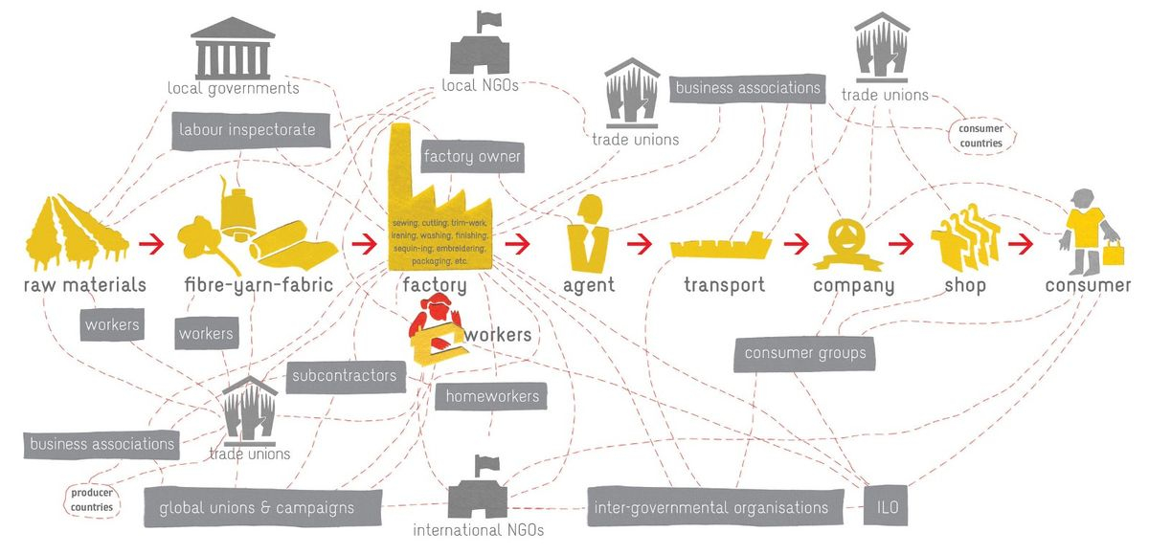
Vizualisation of Supply Chain Management

Slide 12
Study program
The name of the subject: | Logistic Simulations
Lecturer | Position, degree, master
Credit Points: | 3 ETCS
Evaluation method: | Graded evaluation
Used simulations: | PTV Smart Tour, Chainsim (TTK LogLab)

Slide 13
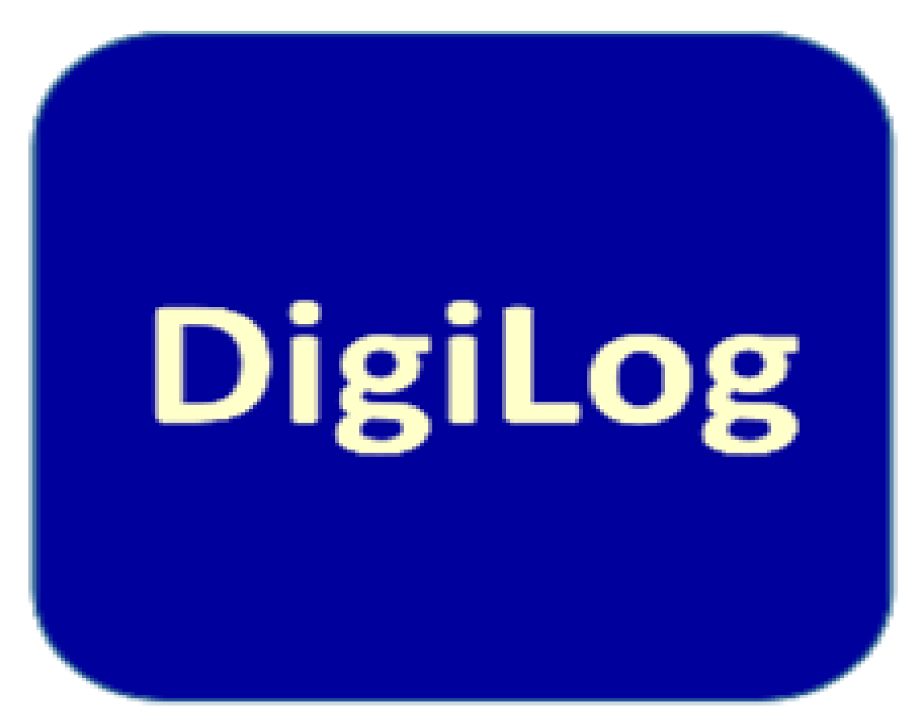
Learning outcomes
Measuring cost and performance in Supply Chain.
Understanding the basic frame and key issues of Supply Chain and Production Planning.
Develop analytical methodologies for Supply Chain analysis.
Develop systematic thinking and making students understand that every decision affects the whole chain.
Learn how to optimize the basic cost of procurement, inventory management and transport logistics.
Supplier selection, assessment, sourcing strategies, total cost optimization. Bill of materials.
Learn how to apply Lean manufacturing concepts.
Can contribute to a holistic approach.

Slide 14

Supply Chain Management Simulation
(TTK, 3 ECTS)
To develop independent thinking and the ability to see the connections between different parts in supply chain.
Simulation will enable students to solve complex business problems related to the journey of products and services from the manufacturer or provider to the end customer. Students will gain an understanding of the techniques required for managing and improving the integration of resources, processes and customer requirements.
Simulations helps to understand principles, theories and practices of material requirements planning (MRP) and supply chain management, critically evaluate and link those to various aspects of performance.

Slide 15
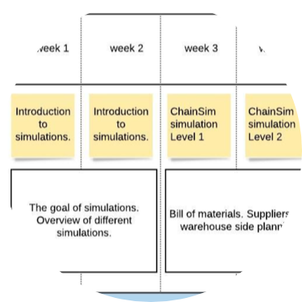

Carpe Diem
Module courses were designed using Carpe Diem, a team-based, student-centered e-learning design methodology. It provides a general outline of the course, setting out goals and objectives, learning outcomes, and the manner of assessment.
Storyboard representing the “student journey”, showing how lessons are actually carried out.

Slide 16
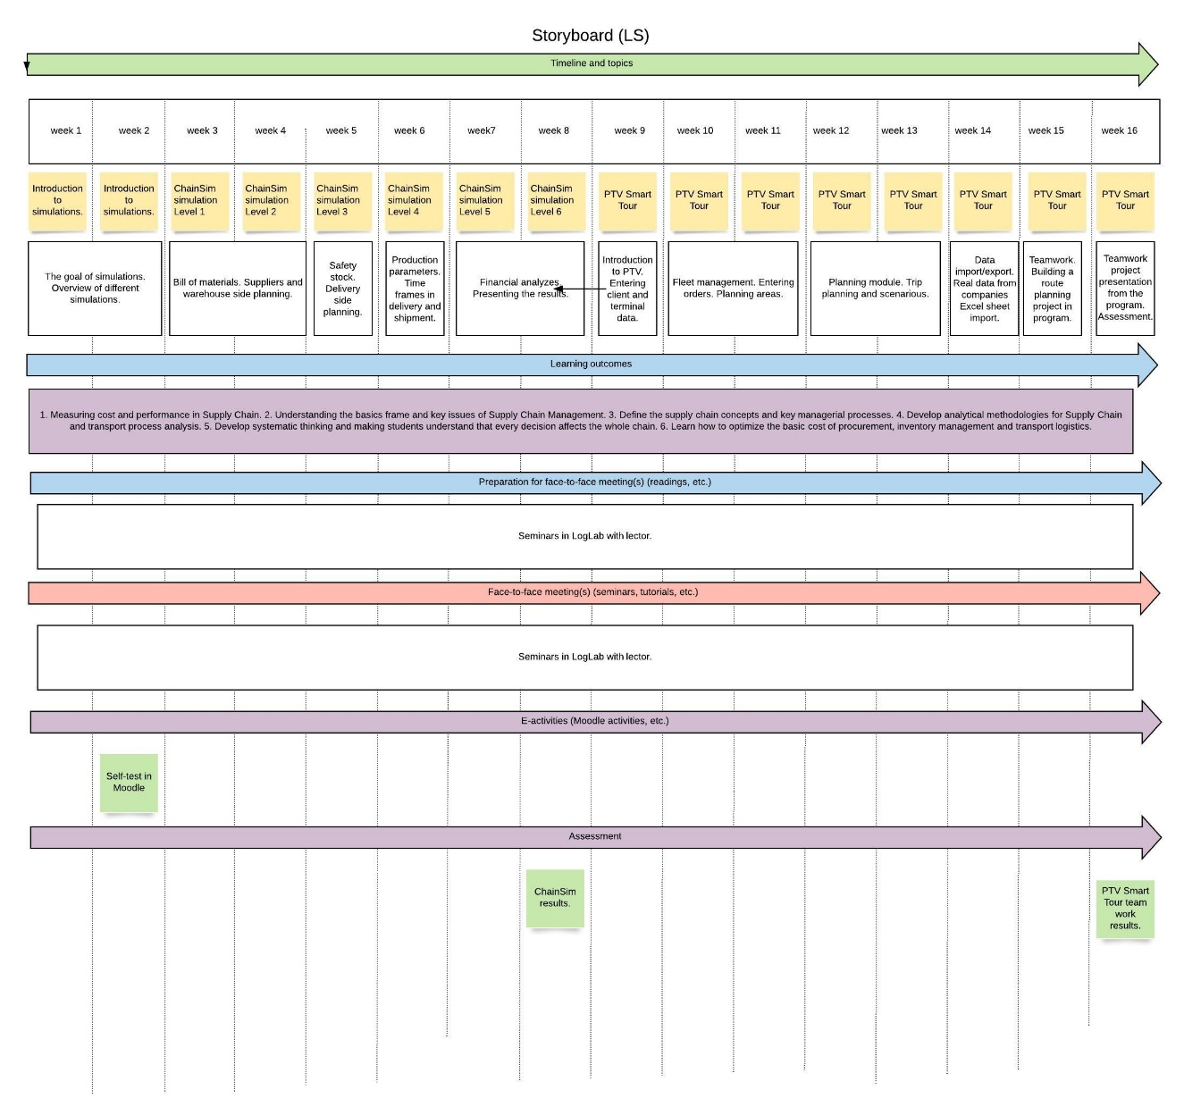


Carpe Diem Storyboard

Slide 17
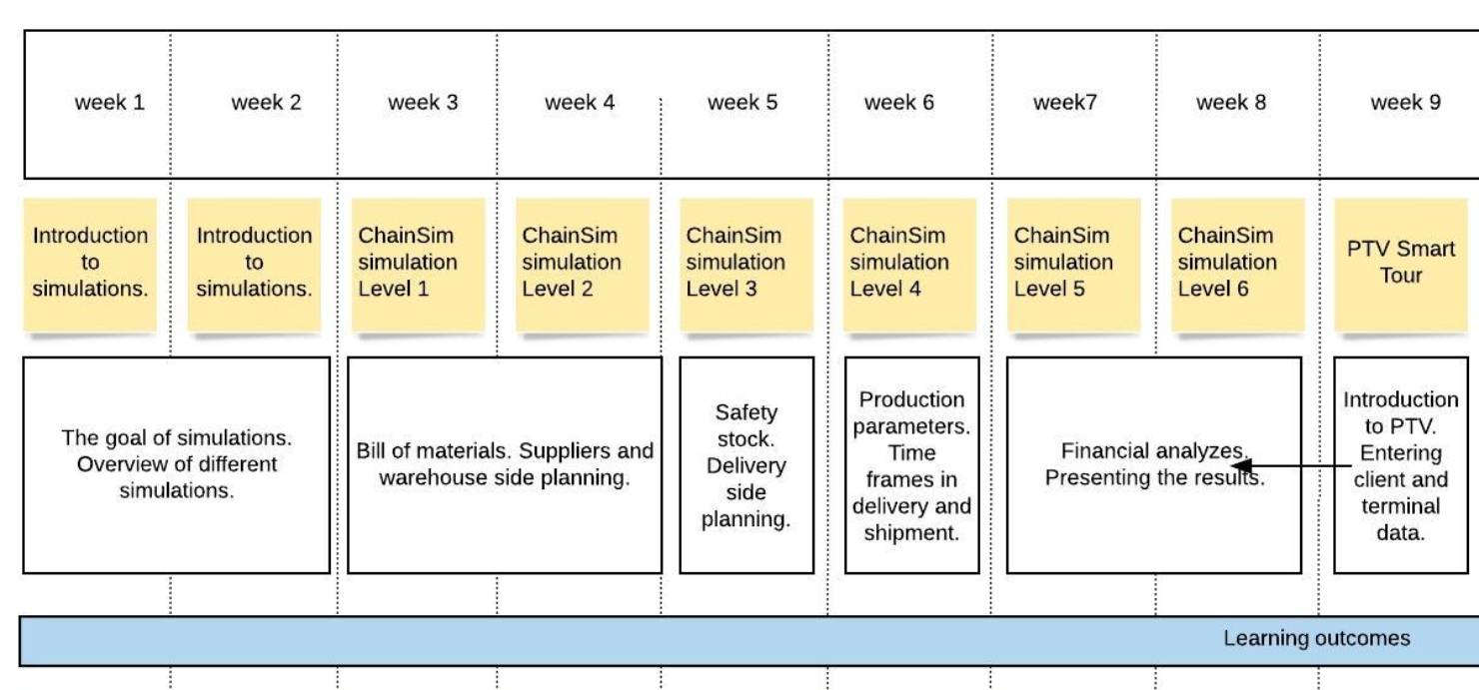
Carpe Diem Storyboard zoomed in

Slide 18
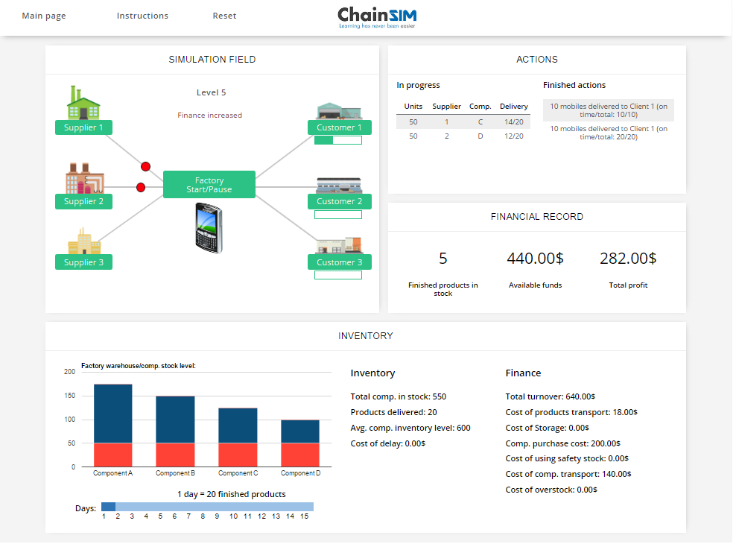
Supply Chain Management online competition for students

Slide 19
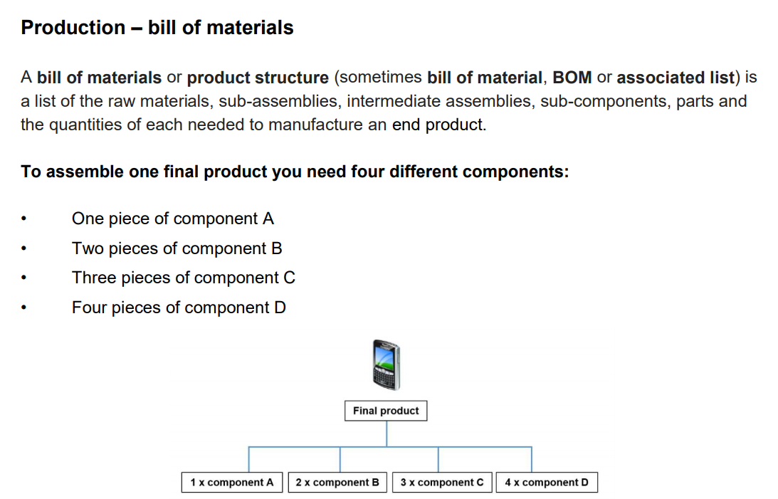

Slide 20
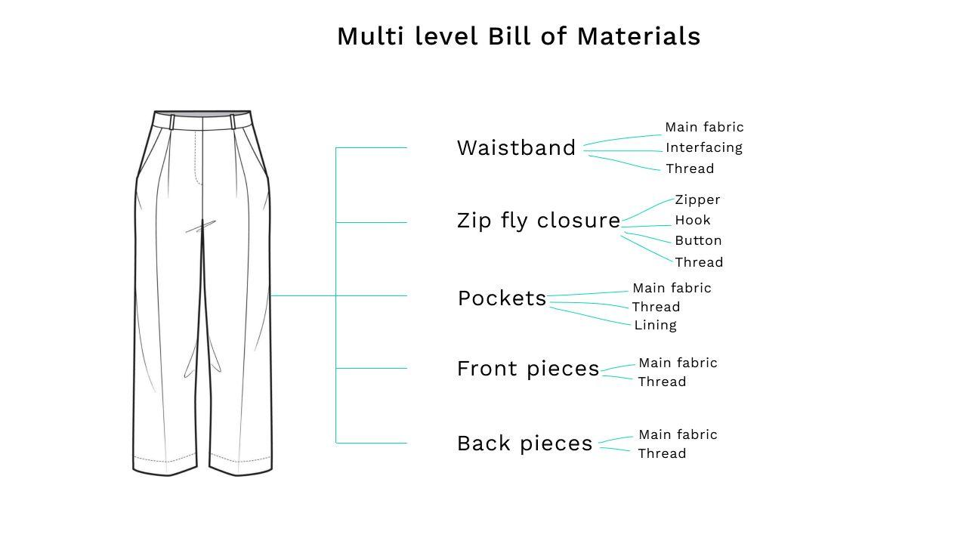

Slide 21






Procurement
What is it?
Procurement and supply management involves buying the goods and services that enable an organisation to operate in a profitable and ethical manner.
What's involved?
Responsibilities vary from sourcing raw materials and services to managing contracts and relationships with suppliers.
Why does it matter?
Procurement is often responsible for up to 70% of companies' revenue, so small reductions in costs can have a huge impact on profits.
www.chips.org

Slide 22


Procurement Life Cycle
Stage 1 – Identify need. The business has a requirement and a purchase is required to fulfil it.
Stage 2 – Specification. This is the documented statement of requirements.
Stage 3 – Make or buy? The ‘make’ - fulfil the need internally, whereas the ‘buy’ - purchase from a third party.
Stage 4 – Identify suppliers. Involves searching and analysing and identifying suitable and appropriate resources.
Stage 5 – Source selection. This involves identifying the preferred supplier to supply the goods or services.
Stage 6 – Negotiate contract. Once a supplier has been selected there may need to be several rounds of negotiation.
Stage 7 – Receipt and payment. Payment for goods and services.
Stage 8 – Manage contract. The contract needs to be managed in order to ensure performance by the supplier.
Stage 9 – Consumption. The bought-in goods and serviced are utilised during the life of the contract.
Stage 10 – Decommission and disposal. The end of the life cycle involves the disposal of the product.

Slide 23
ABC analyze
ABC Analysis also referred to as ABC Classification, is an integral part of material management. It is an inventory categorization method, which classifies the inventory primarily into three distinct categories based on the revenue generation.

Slide 24
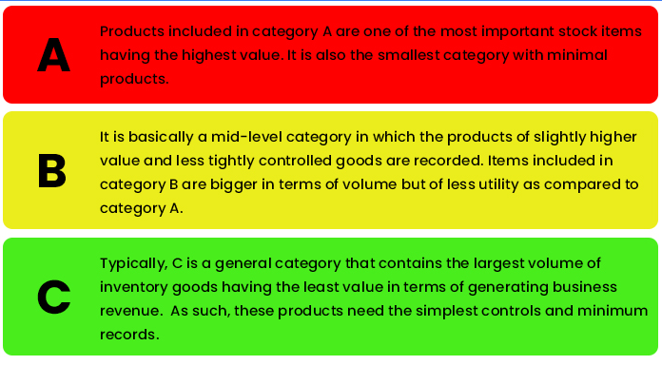
ABC Analysis is based on the theory that all inventory items cannot have similar or equal value.

Slide 25
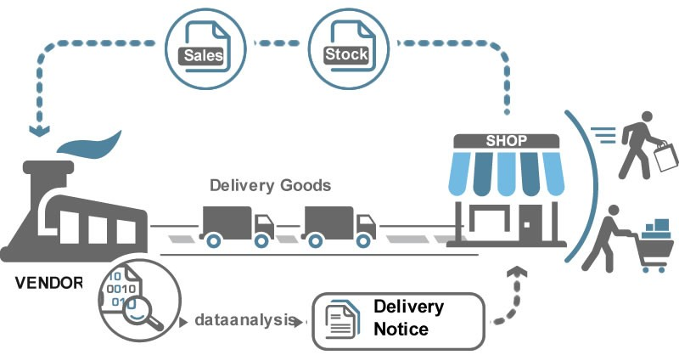
What does it mean VMI in supply chain management?

Slide 26
Vendor Managed Inventory (VMI)
Vendor Managed Inventory (VMI) is an alternative to the traditional order‐based replenishment practice, being a more efficient supply chain integration strategy and collaboration concept. In a VMI relationship, the supplier is empowered to manage customer’s inventory and replenish the goods at customer site automatically under agreed conditions and rules.
Instead of sending the purchase orders, retailers send inventory and sales information electronically to supplier. Based on this demand data, supplier makes periodic resupply decisions regarding order quantities, shipping, and timing. The information about real demand will be transparent to the vendor, reducing uncertainty for its production and operational planning.

Slide 27
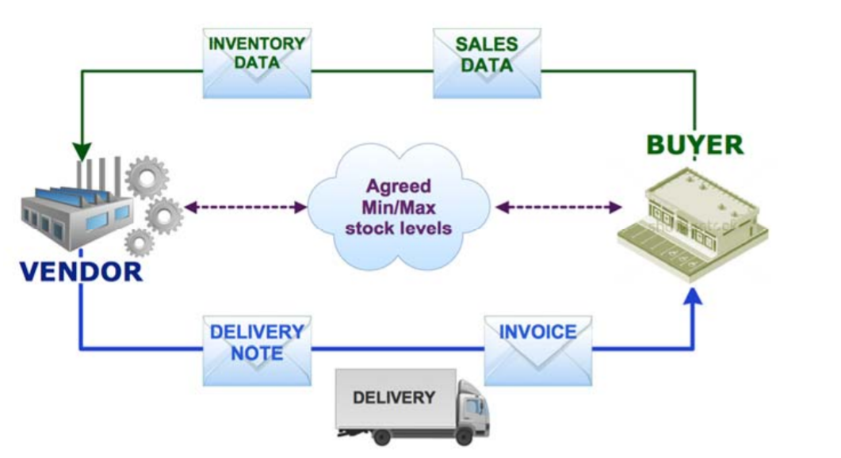
Vendor Managed Inventory (VMI)

Slide 28
Advantages of Vendor Managed Inventory (VMI)
Improved efficiency. Having too much inventory can be costly and take up precious real estate on your shelves, while not enough inventory can cost you sales and delay customer orders. Having the right balance is important not only for your budget, but for your shelf space.
Cost reduction. Having to carry extra stock can be expensive, while inadvertently running out can cause disruptions and lost sales.
Reduced complexity. Working with a VMI partner to handle your inventory means not having to deal with multiple vendors. Improved data insights. As the vendor and business relationship grows, the supplier can anticipate demand and make data-driven decisions to handle seasonal or market trends.

Slide 29
Vendor Managed Inventory (VMI)

Slide 30
LEAN philosophy
In supply chain management

Slide 31
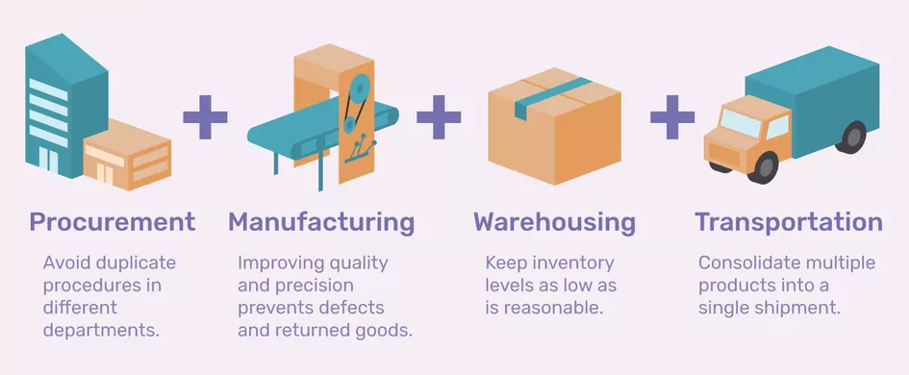
In Lean supply chain management, the focus is on the relentless elimination of non-value added time and consequent reduction of lead time at every step of the supply chain from the manufacturing of raw materials by suppliers to the delivery of finished goods to the end user.

Slide 32
The Four Major Elements of LEAN Supply Chain Management
Integration
Refers to the management of communications and information between the stakeholders in the supply chain. Providing timely and effective interactions across the entire supply chain.
Purchasing & Procurement
You can’t make something from nothing. Procurement is the process of finding, evaluating and engaging suppliers to supply your business with resources and inputs.
Purchasing & Procurement
You can’t make something from nothing. Procurement is the process of finding, evaluating and engaging suppliers to supply your business with resources and inputs.
Distribution & Logistics
The supply chain ends with the delivery of your product or service to the customer. Think of the distribution and logistics network as the blood vessels suppling every facet of the Lean Supply Chain with what it needs and when it needs it.

Slide 33
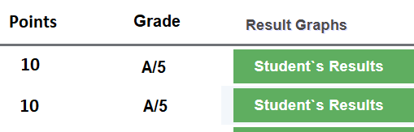

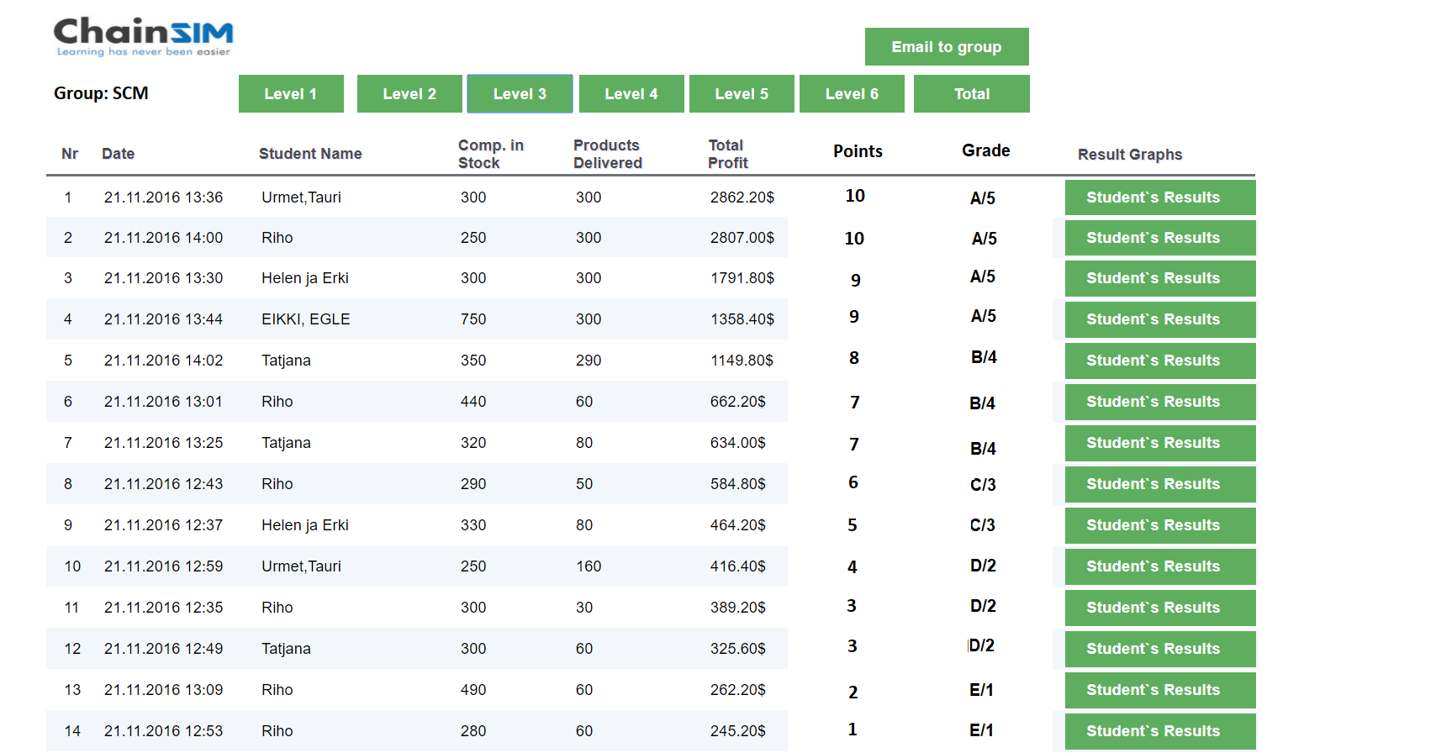
Ranking list of competition results

Slide 34
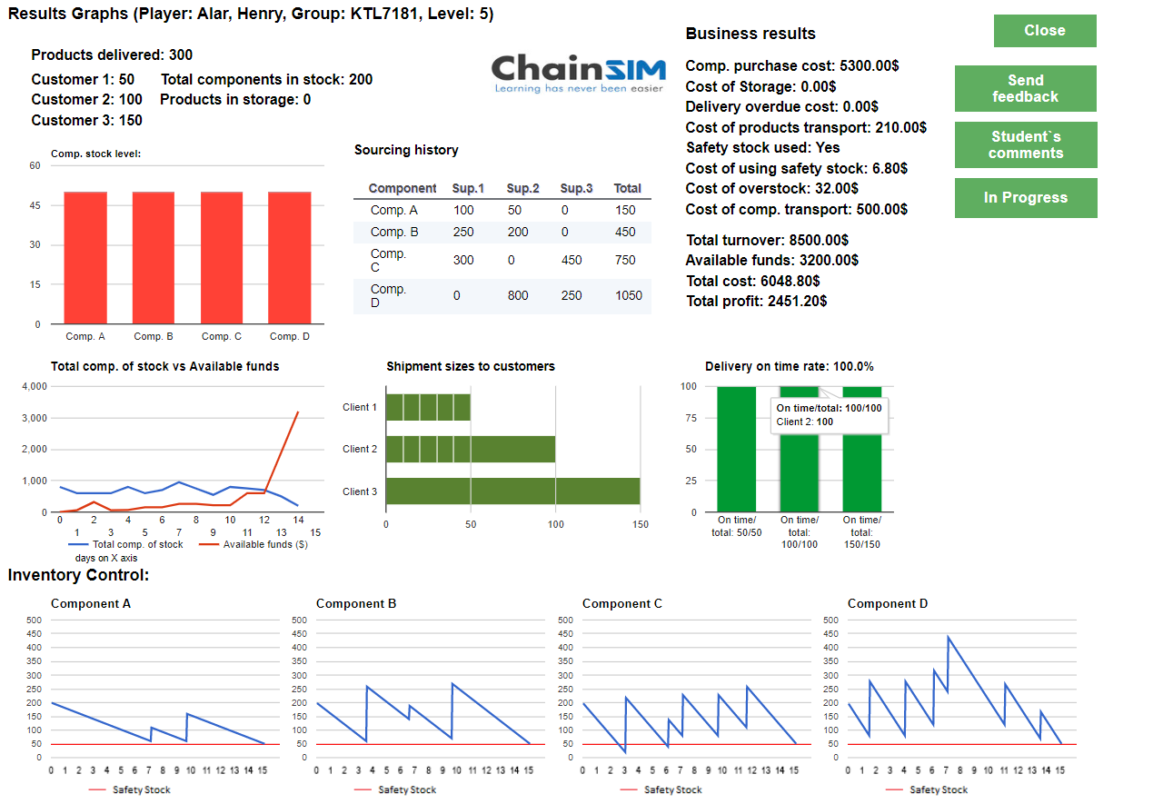
Detailed results overview of each student

Slide 35
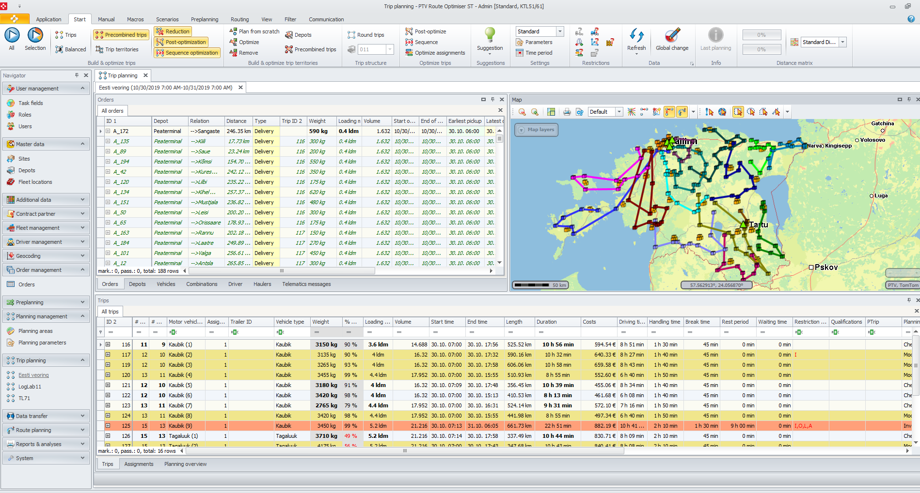
Distribution management

Slide 36


TTK LogLab
PTV Route Optimiser calculates all alternative routes and displays them on a map. The software suggests a suitable vehicle for each trip and provides additional information like the calculated travel time and distance as well as the costs involved.

Slide 37
Thank you for your attention!
Questions?

